Slide 1
Healing Hands
Pilates and Wellness
My simple guide to Pilates on the go!
So enjoy, listen to your body and have fun!!!
Like any workout regimen you should consult your physician before beginning. Please feel free to email me with any questions you may have.
Healinghandspilatesandwellness@yahoo.com
Notes:
Add picture of pilates

Slide 2
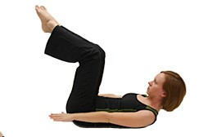
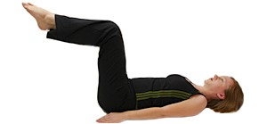
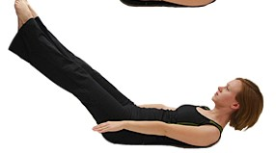
100’s Suck but do them anyway!!!
Tip: Imagine squeezing newspapers under your arms.
The 100’s: Start laying flat on the mat. Depending on your level, you decide what position you start in. 10 pumps per breathe do that 10 times and you survived your exercise. *Remember scoop your abdominals deep into your spine , the pumping should come from your upper back muscles not your arms. Do this 3-4 times a week.

Slide 3
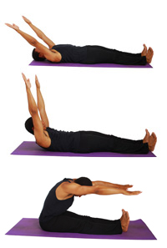
The Roll Up! (not a fruit rollup)
Tip: Squeeze your inner thighs. If lower back hurts bend knees.
Start laying on your back feet should be supported above the ankle. Feet flexed arms are either along your side or up towards the ceiling. Lift head first, then chest, then each vertebrae pulling your stomach in as much as you can. Roll all the way up. As you go down make sure you bring your hips under and place your lower back first on the mat. Have Fun! This one should burn! 5 x’s or more or less you decide.

Slide 4
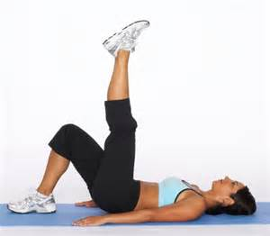
Single Leg Circles
Make sure the leg on the floor is pushed down to the mat and foot is flexed
Tip: lower back issues bend the knee that’s on the floor.
Laying on your back, one leg on the floor the other leg straight up to the ceiling. The leg up to the ceiling will start across the body. Go across the body more than out to the side. 5 Circles one way then reverse and go the other way.

Slide 5
Rolling Like a Ball
New Exercise this month
Start off slow , Lower your body down to start off then start rolling if you are comfortable.
*Keep in mind if you have spine issues to be careful with this exercise.
Don’t do if you have osteoporosis, severe scoliosis
Nov2016
Sitting up, knees bent, Heels together toes apart. Round your spine scoop your belly. Roll Back and Forth.

Slide 6
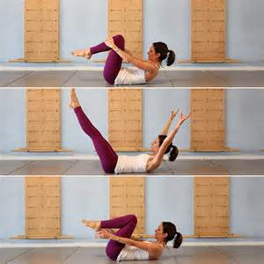
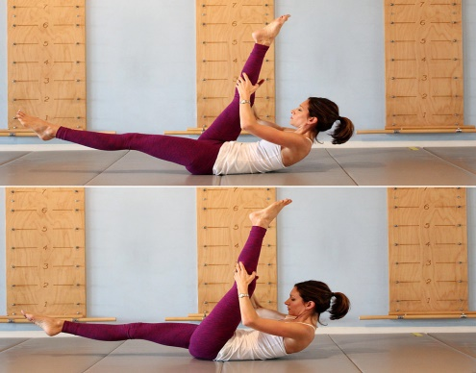
Stomach Series
Single leg stretch. Both hands on right leg to start, upper curl and then switch to the other leg 5 sets. Don’t skip this one. If your neck or back hurts keep your head down until you are strong enough to move on.
Double Leg Stretch. One hand on each shin. Upper curl, both legs go out(together) arms go up and circle around. Do this at the same time.
Scissors. Legs start up towards the ceiling. Hold on to ankle or calf, upper curl. Left leg comes down and then switch grab the other leg.
Head can stay down if you have neck issues
Challenge: work up to doing these exercises 2x in a row and everyday to flatten abs
Stomach series consists of 5 exercises. Ideally you want to do all of them. Even if you have to modify the exercise and take a break in between. Any pain in the lower back means weakness in the abdominal so start off slow and don’t push yourself. Or skip exercise until you are strong enough.

Slide 7
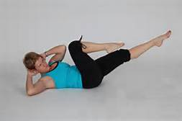
STOMACH SERIES Continued
Double Leg Lower Lift. Cup your hands behind your head. Both legs up to the ceiling. Start off slow…..lowering both legs. No pelvis rocking. Body should be still. Legs can go as low as you can keep your pelvis steady.
This is an advanced exercise so don’t worry if this isn’t for you in the beginning. You can also keep your head down with your hands underneath your sacrum area for better support.
Tip: Reach elbows up to the ceiling to help the upper curl bend
Elbow to Knee. Knees start bent, upper curl, then start with one elbow reaching toward the opposite knee. The other leg will go straight out. Try to touch knee with elbow, also stay in the upper curl. The challenge is to not fall back to switch to the other side. Burn Baby Burn….
These are advanced exercises, try them anyway and see where you are at as far as ability and then you can judge at how strong you are getting. If you are consistent with doing these exercises you will see the difference in your body. Listen to your body!!

Slide 8
SPINE STRETCH FORWARD
New Exercise this month
Squeeze your butt!
Push your hamstrings down to the floor
See how she is lifting and not collapsing her spine. This should not be easy!! If it is your doing it wrong!!
Imagine a ball is in your lap and you need go over that ball
Nov2016
Sitting up straight to start. Lift from your lower spine and bend forward.

Slide 9
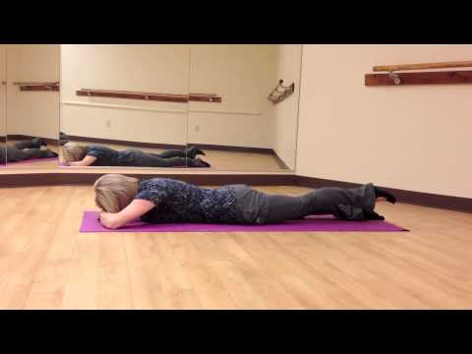
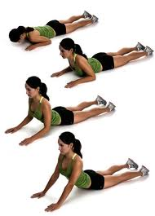
SWAN
This position is great for tight shoulders. It will allow you to squeeze your shoulder blades together
Bring your hands up towards the ceiling and lift chest. Pull your belly away from the mat
Start face down hands underneath your shoulders. Slightly pushing your hands on the floor to help you lengthen your spine forward then up. The Extension is not a compression but a lengthening in the spine. I feel this is an important exercise because we spend most of our day hunched over and we need to strengthen our spine
This is modified for those who will feel it in the lower back or have spine issues. You will still open up the front of your spine and it works the hamstrings.
I Chose a few different pictures for a few reasons. Know your body and follow the directions. Each picture is correct on how to do swan. If you feel lower back discomfort you are compressing your spine so don’t worry about how high you go.

Slide 10
Stay tuned for more exercises to add to your routine…………
5 Pilates on the go exercises
1. 100’s 100 pumps
2. Roll up 5x
3. Single leg circles 5 each way
4. Rolling Like a Ball *
5. Stomach Series 5 sets I dare you to do twice
A. Single leg stretch
B. Double leg stretch
C. Scissors
D. Double leg lower lift
E. elbow to knee
6. Spine Stretch Forward 5x *
7. Swan 5x
Healing Hands Pilates and Wellness
Website: Healinghandspilatesandwellness.com
Healinghandspilatesandwellness@yahoo.com

